Slide 1
Fresh Grads – Group Project
Doctor Appointment System
TEAM
Abisheak Balakrishnan
Avinash Reddy Nalamalapu
Narasimhareddy Mandalapu
Pavankumar Allur
Satish Kumar Pullagaru
Sharath Kumar A
Venkata Mallikarjuna Varma Kolukuluri

Slide 2
INTRODUCTION
Why DocApp System?
Benefits
Goal

Slide 3
Problem Statement
To Create an Application for online appointment with Doctor
Patient can Login/Signup to application.
Patient can add/update/delete their details.
Patient should be able to book appointment.
Patient can give the feedback about Doctor .
Doctor can login and view the list of appointment.
Doctor can add/update/delete their details.
Doctor can view list of patient’s issues.
Doctor can view patient’s appointments.
Doctor can adjust the time slot.
Doctor can view feedback.

Slide 4
Road Map
Application will be developed in following Sprints –
Core Java +JPA with Hibernate
Spring Boot + Rest Controller + JPA with Hibernate
React JS for UI design (Front End) + Integration with previous Sprint(future implementation)

Slide 5
Plan
Design
Generate the skeleton as per class design provided
TDD approach
Identify test cases for each module
Write Failing Test cases
Convert the Test Cases in GREEN
Implement the case study in incremental manner

Slide 6
Modules
Admin Module
Doctor module
Patient Module
Availability Module
Appointment Module
Patient Issues Module
Feedback Module

Slide 7
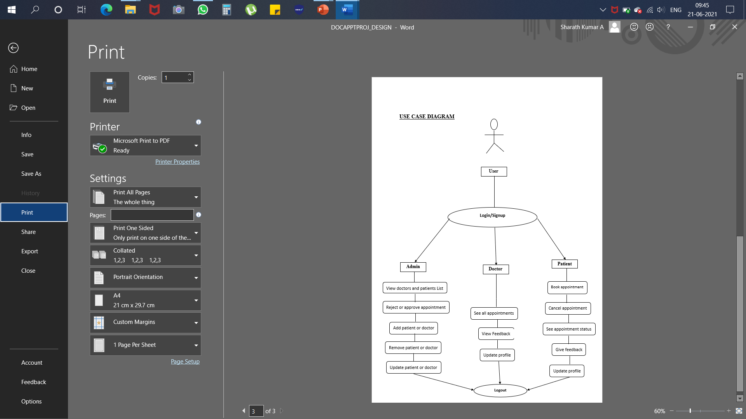
Use-case Diagram

Slide 8
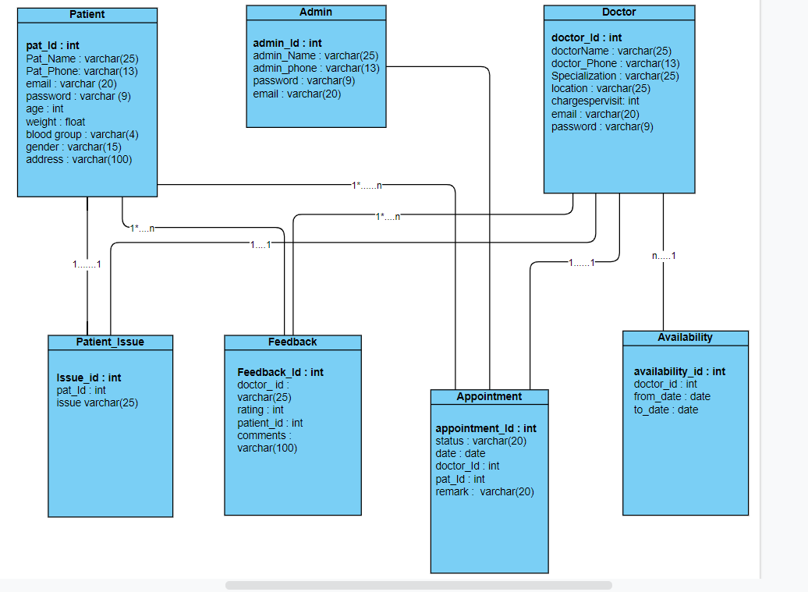
Class Design
POJO Classes:

Slide 9
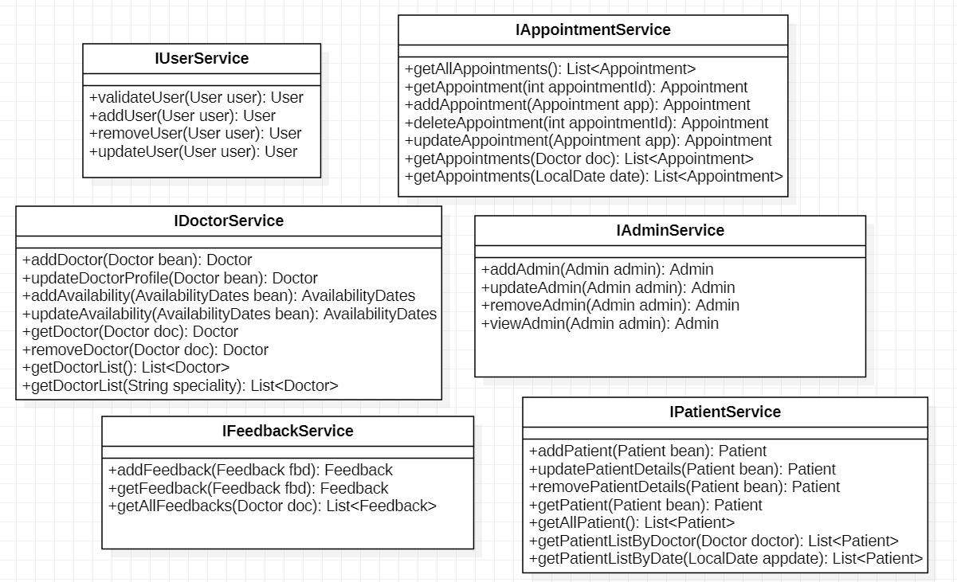
Class Design
Service Interface:
IPatientService
+getAllPatientIssues():List<PatientIssues>
+addPatientIssue(PatientIssue patientIssue): PatientIssue
+findPatientIssueByPatientId(Integer patientId):PatientIssue

Slide 10
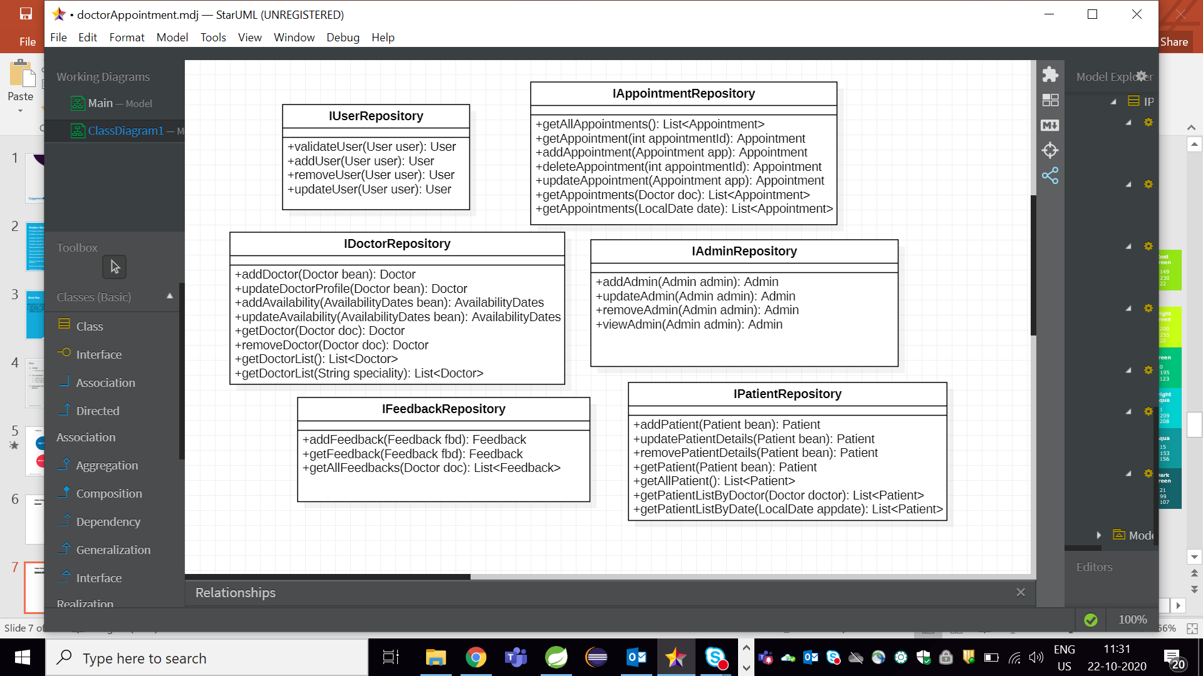
Class Design
Repository:
IPatientRepository
+getAllPatientIssues():List<PatientIssues>
+addPatientIssue(PatientIssue patientIssue): PatientIssue
+findPatientIssueByPatientId(Integer patientId):PatientIssue

Slide 11
Tables
Attribute | Data_type | Constraints
Admin_id | Int | Primary_key
Admin_name | Varchar(20)
Admin_phone | Varchar(13)
Password | Varchar(9)
Email | Varchar(20)
Admin
Attribute | Data_type | Constraints
Patient_id | Int | Primary_key
Patient_name | Varchar(20)
Patient_phone | Varchar(13)
Email | Varchar(20)
Password | Varchar(9)
Age | Varchar(3)
Weight | Float
Blood_group | Varchar(5)
Address | Varchar(50)
Gender | Varchar(15)
Patient

Slide 12
Attribute | Data_type | Constraints
Doctor_id | Int | Primary_key
Doctor_name | Varchar(20)
Doctor_phone | Varchar(13)
Email | Varchar(20)
Password | Varchar(9)
Specialization | Varchar(3)
Location | Varchar(20)
Charges_per_visit | Varchar(5)
Doctor
Attribute | Data_type | Constraints
Apointment_id | Int | Primary_key
Appointment_date | Date
Appointment_time | Time
remarks | Varchar(50)
Appointment

Slide 13
Attributes | Data_types | Constraints
Availability_id | Int | Primary key
From_date | Date
To_date | Date
Availability
Attributes | Data_types | Constraints
Patientissues_id | Int | Primary key
Patient_id | Int
Issues | Varchar(30)
Patient_Issues
Attributes | Data_types | Constraints
Feedback_id | Int | Primary key
Rating | Int
Comment | Varchar(100)
Feed_back

Slide 14
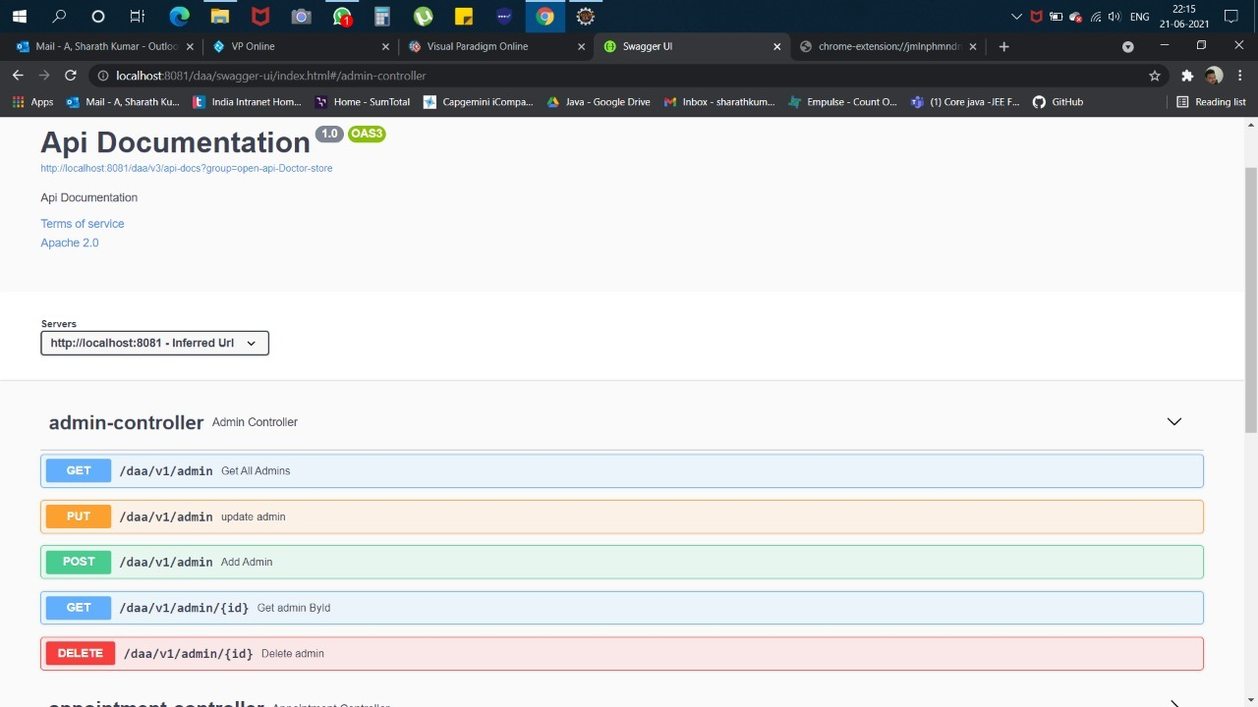
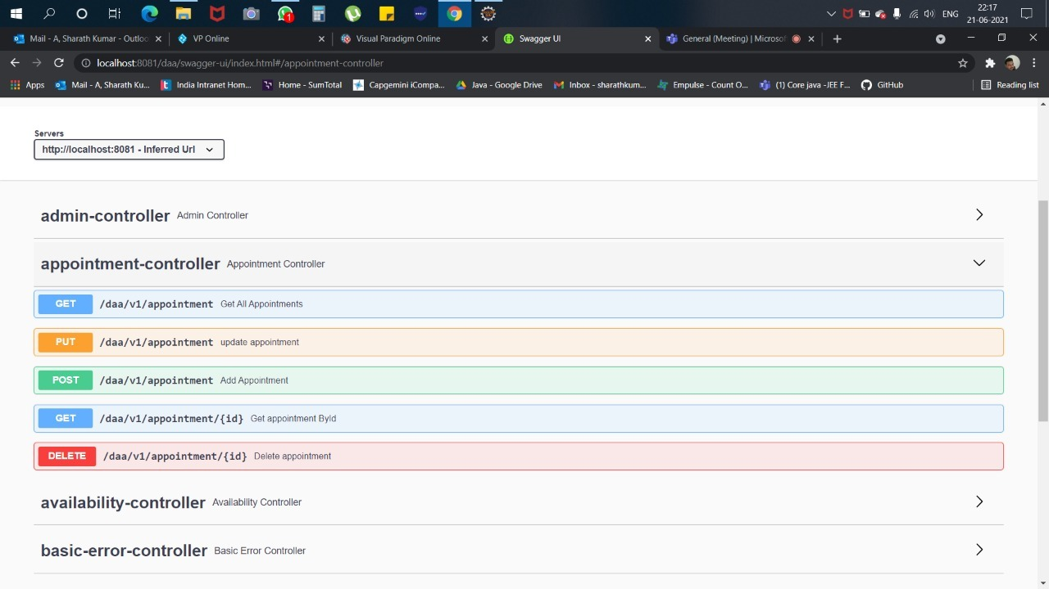
Swagger Implementations

Slide 15
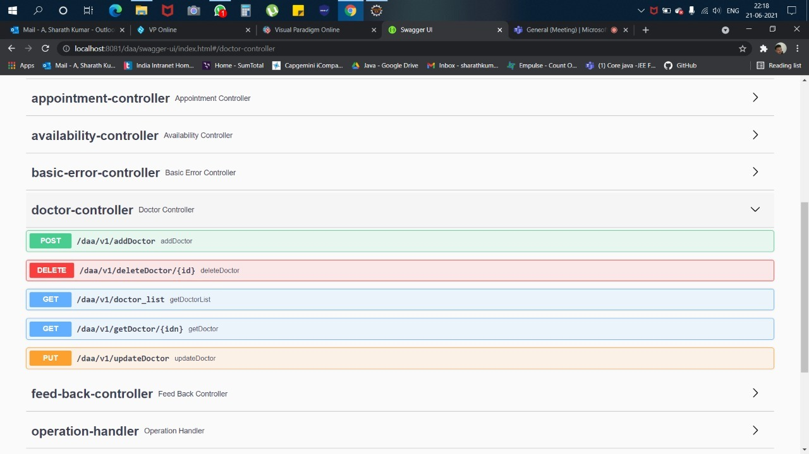
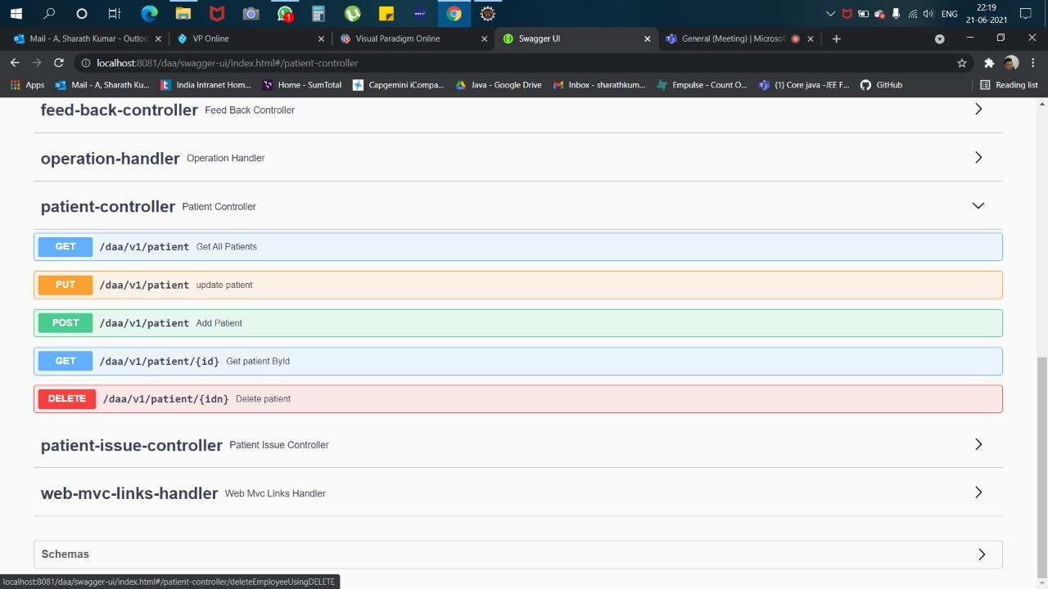

Slide 16
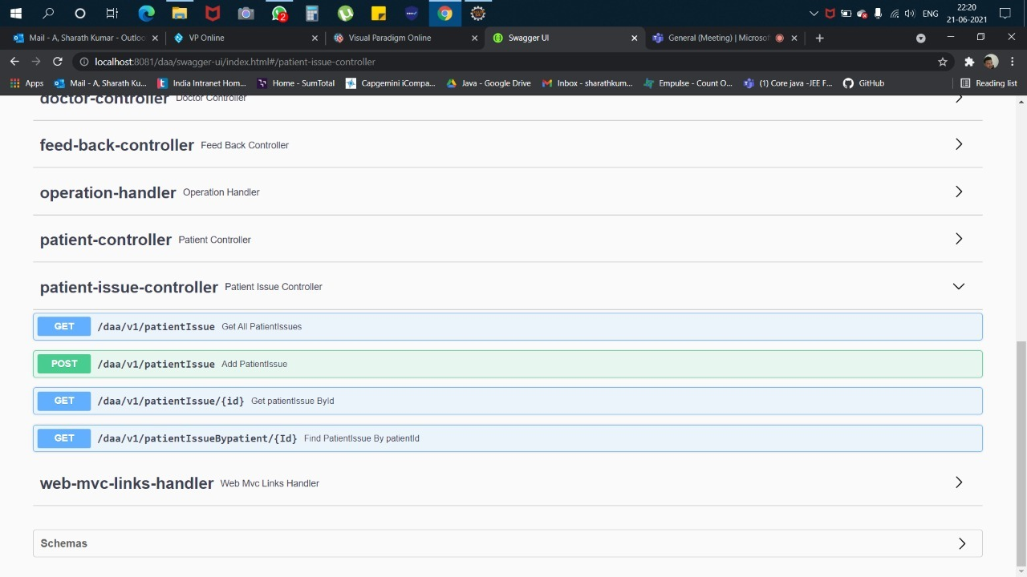
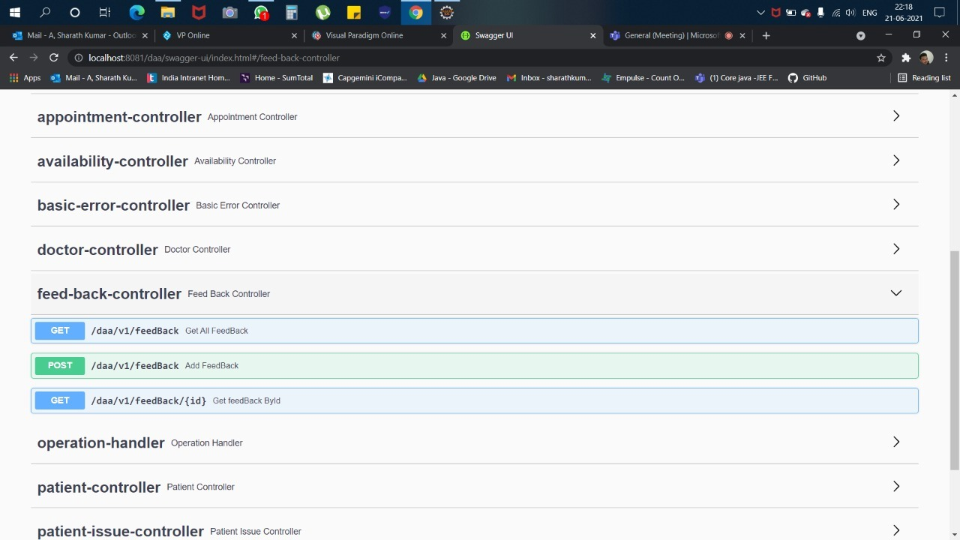

Slide 17
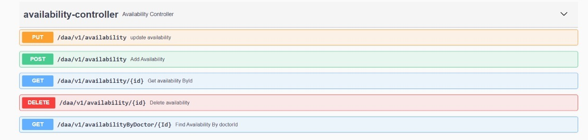

Slide 18




Questions

